Slide 1



Slide 2


Slide 3
Characteristics
Not using the relational model (nor the SQL language)
No schema, allowing fields to be added to any record without controls
Do not support join operations
May not give full ACID guarantees
Designed to run on large clusters
Open source (mostly)
Notes:
Beskriv generella drag för NoSQL Databaser. Allt är inte open source.
Det finns en del som stödjer viss T-SQL
(atomicity, consistency, isolation, durability)

Slide 4
Main types of NoSQL Databases
Key-value stores (Cassandra, Redis)
Big Tables (Google BigTable)
Document stores (CouchDB, MongoDB, RavenDB)
Graph databases (Neo4j)
Notes:
Kort beskrivning av de olika kategorierna. Key-value stores finns i många varianter. Stored on disk, In-memory only.
Cassandra = Facebook (används som en del i deras lagrings arkitektur)
CouchDB är lite av förlagan till RavenDB
Amazon, linkedin, twitter, facebook,

Slide 5
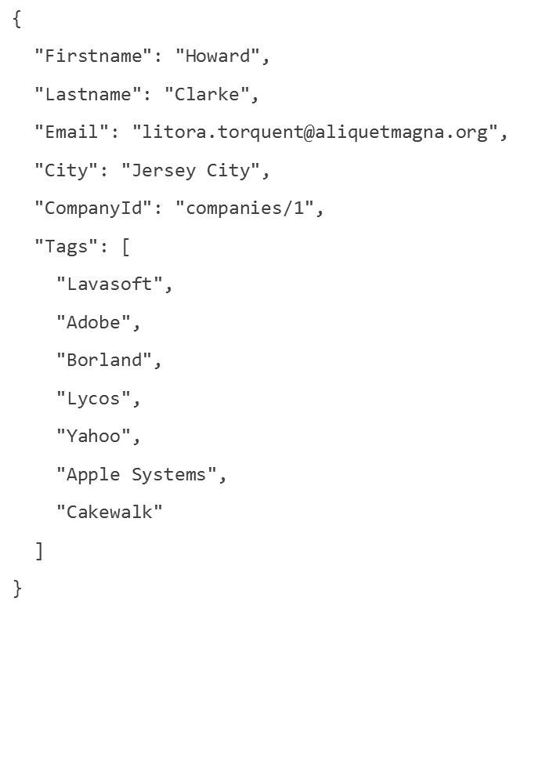
Json (Javascript Object Notation

Slide 6
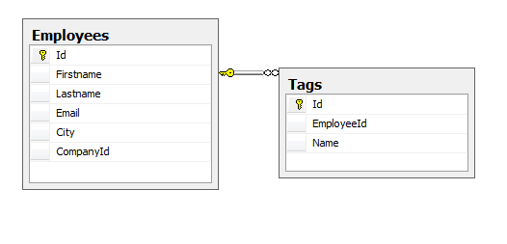
{
"Firstname": "Howard",
"Lastname": "Clarke",
"Email": "litora.torquent@aliquetmagna.org",
"City": "Jersey City",
"CompanyId": "companies/1",
"Tags": [
"Lavasoft",
"Adobe",
"Borland",
"Lycos",
"Yahoo",
"Apple Systems",
"Cakewalk"
]
}
Notes:
Json = javascript object notation

Slide 7
REST Representational State Transfer
REST is an architecture style for designing networked applications. The idea is that, rather than using complex mechanisms such as CORBA, RPC or SOAP to connect between machines, simple HTTP is used to make calls between machines.
HTTP Verbs
GET
PUT
POST
DELETE

Slide 8
Resource | GET | PUT | POST | DELETE
Collection URI, such ashttp://example.com/resources/ | List the URIs and perhaps other details of the collection's members. | Replace the entire collection with another collection. | Create a new entry in the collection. The new entry's URL is assigned automatically and is usually returned by the operation. | Delete the entire collection.
Element URI, such ashttp://example.com/resources/item17 | Retrieve a representation of the addressed member of the collection, expressed in an appropriate Internet media type. | Replace the addressed member of the collection, or if it doesn't exist, create it. | Treat the addressed member as a collection in its own right andcreate a new entry in it. | Delete the addressed member of the collection.

Slide 9


Slide 10
RavenDB is a transactional, open-source Document Database written in .NET
Data is stored schema-less as JSON documents
.NET Client API with Unit Of Work
Notes:
Stödjer distributed transactions

Slide 11
Query with LINQ (in .NET)
Query with RESTful API
- Representational state transfer
Notes:
Demo: c#
http://alva:8080/databases/salespeople/docs/employees/1

Slide 12
Safe by default
RavenDB prevents you from doing stupid things
Max number of request within a session
No unbound result sets
Notes:
Best practices = n+1, Take(128), max 30 SaveChanges in one request

Slide 13
Eventually consistent
BASE Basically Available, Soft state, Eventual consistency
ACID for writes
BASE for reads
Notes:
Background threads creates the indexes, you can get stale data

Slide 14
Attachments
Attachments in RavenDB can have metadata, are replicated between nodes, can be cascade deleted on document deletions and are HTTP cachable.
You can load large chunks of data concurrently to loading the entities, so data is displayed without much delay and doesn't suffer from the size of the data attached to it.

Slide 15
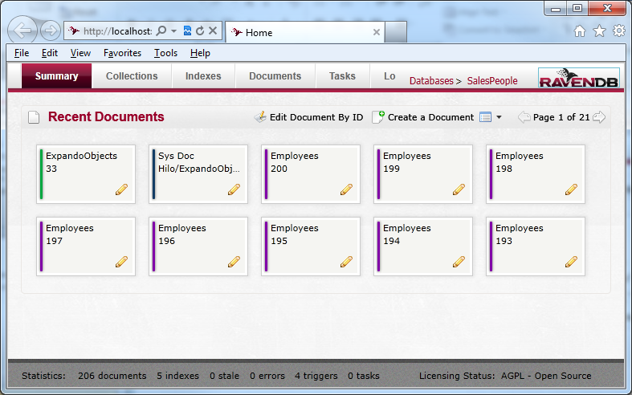
Raven Studio
Notes:
Grafiskt gränssnitt för servern
Localhost:8080
Silverlight

Slide 16
Ways to run RavenDB
Debug mode (console)
Windos service
IIS
In memory (for testing)
Embedded HTTP Server
Notes:
RavenDB kan köras på många sätt

Slide 17
Main building blocks
HTTP Server
Lucene (high-performance, full-featured text search engine)
Esent (embeddable, transactional database engine)
NLog (logging)
Json.NET (JSON serializer )
Notes:
The ESENT database engine can be used whenever an application wants high-performance, low-overhead storage of structured or semi-structured data. This can range from something as simple as a hash table which is too large to store in memory to a complex application with many tables, columns and indexes. ESENT is used by the Active Directory, Windows Desktop Search, Windows Mail and several other Windows services and a slightly modified version of the code is used by Microsoft Exchange to store all its mailbox data. The ESENT API is available through the SDK and can be used on all versions of Windows from Windows Server 2000 on up.

Slide 18
Demo 1
Install RavenDB
Connect to RavenDB
CRUD operations
Notes:
Säg något i stil med: ”Ja, medan ni funderar på det tänkte jag berätta lite om Crepido.”

Slide 19
Ids
Default (”employees/1”)
Overrides (int, guid)
Natural keys (email, ssn)

Slide 20
Indexes
You always query an index
If no index specified in query
Query optimizer will look for an index that can handle the query
If no index found, a dynamic index is created
If the dymaic index is used over and over again it gets promoted to a permanent index
Notes:
RavenDB indexes the document in the background. When we store or update a document RavenDB puts it in a queue. Then a background tasks picks it up and updates all the existing indexes. However this implies also that an index (and remember, a query always uses an index) might return a stale result. When we store a document and then use an index the document is maybe not in there yet.

Slide 21
Index can be created in Code
Index can be created by you in Raven Studio

Slide 22
RavenDB indexes the document in the background. When we store or update a document RavenDB puts it in a queue. Then a background tasks picks it up and updates all the existing indexes. However this implies also that an index (and remember, a query always uses an index) might return a stale result. When we store a document and then use an index the document is maybe not in there yet.
Notes:
Index sample

Slide 23
Demo 2
Indexes
Notes:
Show indexes in Luke

Slide 24
Backups
Relational db integration
Bundles
Sharding

Slide 25
Bundles – extend RavenDb
Sharding and Replication.
Expiration - removes expired documents automatically.
Index Replication - replicates a RavenDB index to SQL Server.
Authentication - authenticates DB users using OAuth.
Authorization - allows to manage user groups, roles and permissions.
Versioning - automatic versioning of documents upon updates or deletes.
More Like This - Returns documents that are related to a given document.
Unique Constraints - adds the ability to define unique constraints to RavenDB documents.

Slide 26
Sharding
Sharding refers to horizontal partitioning of data across multiple machines. The idea is to split the load across many commodity machines, instead of buying huge expensive machines.

Slide 27
Resources
http://ravendb.net
http://www.youtube.com/user/HibernatingRhinos
http://tekpub.com/productions/raven
http://www.dnrtv.com/default.aspx?showNum=204
http://builds.hibernatingrhinos.com/Builds/RavenDBBook
http://groups.google.com/group/ravendb
http://incubator.apache.org/lucene.net/

Slide 28
Klurigt tänkt. Enkelt utfört

